Slide 1
Cloud Security Framework for SwiftTech Solutions Ltd.
Ensuring Secure and Resilient Cloud Infrastructure

Slide 2
Agenda
Overview of the Developed Framework
Business Risk and Potential Threats
Appraisal and Evaluation of Risks
Proposed Mitigations
Supporting Industry Cloud Tools
Failover and Redundancy Plan
Evidence of Applied Security Measures

Slide 3
Introduction
The presentation demonstrates a comprehensive overview of SwiftTech Solutions Ltd.'s cloud security framework. We will explore the identified business risks, potential threats, and the strategic evaluation of these challenges. The report outlines proposed mitigations, industry cloud tools in use, failover strategies, and evidence of applied security measures, offering a holistic view of SwiftTech's resilient cloud infrastructure.

Slide 4
Framework Overview
Cloud Infrastructure Scope and Components:
Our cloud infrastructure spans the entirety of SwiftTech Solutions Ltd.'s operational landscape, providing a comprehensive and integrated framework.
Key Elements: Elastic Web Servers, Enterprise Application Servers, VDI, Document Database:
This framework comprises essential components:
Elastic Web Servers: Utilizing scalable servers such as Apache and Nginx to ensure optimal website performance.
Enterprise Application Servers: Powered by Apache OfBiz, facilitating robust Enterprise Resource Planning (ERP) systems to enhance business operations.
Virtual Desktop Infrastructure (VDI): Empowering secure access to work desktop environments from any location.
Document Database: Transitioning to a non-relational format for enhanced flexibility and scalability.
Emphasis on Scalability, Accessibility, and Support for Remote and On-site Work: Designed with scalability in mind, our framework adapts to varying workloads seamlessly. Accessibility is prioritized for both remote and on-site staff, ensuring a cohesive work experience.

Slide 5
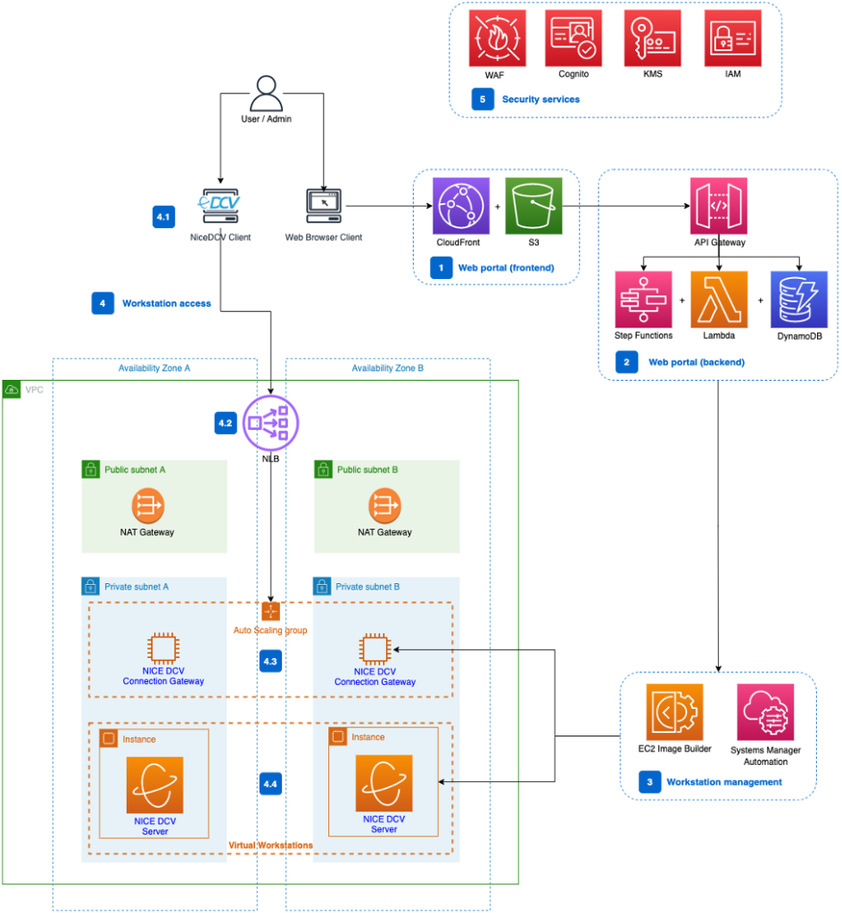
Developed Framework - Key Components
Elastic Web Servers: Utilizing scalable servers (e.g., Apache, Nginx) for optimal website performance.
Enterprise Application Servers: Deployment of Apache OfBiz for ERP systems, enhancing business operations.
Virtual Desktop Infrastructure (VDI): Enabling secure access to work desktop environments from anywhere.
Document Database: Transition to a non-relational document database for flexibility and scalability.

Slide 6
Developed Framework - Document Database
Employee Data: Comprehensive records including names, job roles, and contact information in a document format. Enhancing accessibility and management of employee information.
Customer Data: Storing and managing customer-related information such as names and transaction histories. Organized in a document-oriented structure for efficient retrieval.
Product or Service Data: Housing crucial information about products or services. Includes specifications, pricing details, and service descriptions in a document-oriented format.

Slide 7
Business Risks and Potential Threats
Identification of Business Risks:
Risk: Data Breach
Threats: Unauthorized access, data exposure.
Impact: Loss of trust, legal consequences, disruption to operations.
Risk: Service Disruption
Threats: DDoS attacks, inadequate failover.
Impact: Downtime, financial losses, damage to reputation.

Slide 8
Impact on Operations & Modern Workplace
Potential Threats to Cloud Security:
Threat: Unauthorized Access
Potential Threats: Weak authentication, inadequate access controls.
Impact: Unauthorized access, data manipulation, compromised accounts.
Threat: Data Breach
Potential Threats: Insufficient encryption, lack of monitoring.
Impact: Loss of sensitive information, legal ramifications.
Impact on Modern Workplace Practices:
Impact: Disruption to Remote Work Arrangements
Potential Impact: Unsecured remote access, compromised VDI.
Consequences: Insecure connections, challenges for remote workers.
Impact: Compromised Business Continuity
Potential Impact: Inadequate disaster recovery.
Consequences: Disrupted workflows, extended downtime.

Slide 9
Risk Associated With Each Assets
AssetID A1 (Elastic Web Servers):
Risk: Unauthorized access and exploitation occur through weak server security, allowing attackers to breach web servers.
Impact: This can lead to the compromise of external websites, loss of trust, legal consequences, and disruptions in business operations.
AssetID A2 (Enterprise Application Servers):
Risk: Threats to Apache OfBiz and network vulnerabilities can result from inadequate configuration and monitoring.
Impact: Exploitation of OfBiz may compromise ERP systems, causing business disruptions, financial losses, and potential damage to critical processes.
AssetID A3 (Virtual Desktop Infrastructure):
Risk: Security risks with virtual desktop instances and identity theft stem from weak authentication mechanisms.
Impact: Compromised VDI instances may disrupt remote work arrangements, leading to potential loss of sensitive information and identity theft.
AssetID A4 (Document Database):
Risk: Unauthorized access and lack of encryption occur due to inadequate security measures for the document database.
Impact: This can result in a data breach, loss of confidential information, legal consequences, and disruptions to business operations.
AssetID A5 (IAM and Access Controls):
Risk: Weak IAM policies and identity theft threats arise from improper management of access controls.
Impact: Compromised user accounts, ineffective incident response, and disruptions in business operations can occur.

Slide 10
Risk Associated with Each Asset
AssetID A6 (VPC and Network Configuration):
Risk: Insecure VPC configuration and network breaches can happen due to inadequate security audits and configuration settings.
Impact: Compromised sensitive information, unauthorized access, and risks associated with inadequate security audits may result.
AssetID A7 (Monitoring and Logging):
Risk: Insufficient monitoring and unauthorized access to web servers occur due to poor logging practices.
Impact: Difficulty in detecting and responding to security incidents, leading to compromised incident response and potential disruptions.
AssetID A8 (Data Backup and Recovery):
Risk: Data loss and unauthorized access happen due to inadequate backup procedures and lack of encryption.
Impact: Loss of critical data affecting business continuity, potential unauthorized access to the database, and risks associated with compromised document databases.
AssetID A9 (Incident Response Plan):
Risk: Ineffective handling of security incidents and incomplete incident response plans result from an underdeveloped response strategy.
Impact: Challenges in responding to security incidents, increased risk of prolonged downtime, and potential disruptions to business operations.
AssetID A10 (Regular Security Audits):
Risk: Undetected vulnerabilities arise due to insufficient security audits and weak authentication mechanisms.
Impact: Difficulty in identifying and addressing vulnerabilities, risks associated with insecure virtual desktop infrastructure, and potential compromises in security.

Slide 11
Impact Assessment of Identified Risks
Threat ID | Threat | Asset | Likelihood (out of 10) | Consequence Score (out of 10)
T1, T2 | Unauthorized access, Exploitation of vulnerabilities | Elastic Web Servers | 6 | 8.5
T2, T6 | Exploitation of OfBiz vulnerabilities, Network breaches | Enterprise Application Servers | 7 | 9.2
T3, T5 | Compromised VDI instances, Identity theft | Virtual Desktop Infrastructure | 5 | 7.8
T4, T8 | Unauthorized access to database, Data loss due to lack of backups | Document Database | 6 | 8.7
T5, T9 | Identity theft, Ineffective handling of security incidents | IAM and Access Controls | 6 | 9
T6, T10 | Network breaches, Undetected vulnerabilities | VPC and Network Configuration | 7 | 9.1
T7, T1 | Lack of visibility into security events, Unauthorized access | Monitoring and Logging | 5 | 6.5
T8, T4 | Data loss due to lack of backups, Unauthorized access to database | Data Backup and Recovery | 6 | 8.9
T9, T7 | Ineffective handling of security incidents, Lack of visibility | Incident Response Plan | 6 | 8.3
T10, T3 | Undetected vulnerabilities, Compromised VDI instances | Regular Security Audits | 5 | 7.2

Slide 12
Risk Mitigation Strategies
Risk ID | Identified Risk | Risk Mitigation Strategy/Control Implementation
R1 | Unauthorized access to web servers | - Implement AWS WAF for web servers. - Regularly patch and update web servers (e.g., Apache, Nginx).
R2 | Exploitation of Apache OfBiz vulnerabilities | - Regularly update and patch Apache OfBiz. - Deploy AWS WAF for additional protection.
R3 | Compromised VDI instances | - Implement MFA for VDI access. - Ensure proper encryption for VDI.
R4 | Unauthorized access to the document database | - Implement encryption for the document database. - Regularly review and update access controls.
R5 | Identity theft and unauthorized access | - Enforce the principle of least privilege in IAM. - Implement MFA for privileged accounts.
R6 | Network breaches and data interception | - Utilize VPC for network segmentation. - Configure NACLs and Security Groups. - Conduct regular network audits.
R7 | Lack of visibility into security events | - Enable AWS CloudTrail for logging. - Set up Amazon CloudWatch alarms for suspicious activities. - Implement AWS Config.
R8 | Data loss due to lack of backups | - Establish a robust backup strategy. - Conduct regular backup testing. - Implement automated backup setups.
R9 | Ineffective handling of security incidents | - Develop and test an incident response plan. - Establish communication channels and workflows for handling incidents.
R10 | Undetected vulnerabilities | - Conduct regular security audits. - Utilize AWS Inspector for automated security assessments.

Slide 13
Supporting Industry Cloud Tools
Proposed AWS Services Employed:
AWS Web Application Firewall (WAF):
AWS WAF provides protection against common web exploits and allows SwiftTech to set up customizable web security rules.
Amazon CloudWatch:
CloudWatch offers monitoring for resources and applications, enabling SwiftTech to gain insights into system performance and set alarms for potential issues.
Amazon Inspector:
Amazon Inspector automates security assessments, helping SwiftTech identify vulnerabilities and potential security issues in their applications.
AWS Config:
AWS Config enables SwiftTech to assess, audit, and evaluate the configurations of AWS resources, aiding in compliance and security management.
AWS CloudTrail:
CloudTrail records AWS API calls, providing SwiftTech with visibility into user activity and resource changes for security analysis and compliance.
AWS Key Management Service (KMS):
KMS facilitates the management of cryptographic keys, ensuring the secure encryption of sensitive data and enhancing overall data protection.
AWS Identity and Access Management (IAM):
IAM enables SwiftTech to manage user access securely, ensuring the principle of least privilege and enhancing overall control over their cloud resources.
Amazon Elastic Block Store (EBS):
EBS provides scalable and secure block-level storage volumes, contributing to SwiftTech's data resilience and availability strategies.
Amazon Simple Storage Service (S3):
S3 offers scalable object storage with robust security features, allowing SwiftTech to securely store and retrieve vast amounts of data.
Emphasis on Tools Supporting Risk Mitigation:
Besides these tools additional 3rd party tools such as cisco packet tracer and similar network traffic analysis methods can improve SwiftTech's risk mitigation strategies, offering better security features and continuous monitoring capabilities.

Slide 14
Failover and Redundancy Plan
Overview of Failover and Redundancy Strategies:
SwiftTech Solutions Ltd. prioritizes a robust failover and redundancy plan to ensure uninterrupted service delivery and minimize downtime.
Importance of Minimizing Downtime:
SwiftTech recognizes the critical need to minimize downtime, ensuring continuous availability of services for both internal and external stakeholders.
Key Components of the Redundancy Plan:
Load Balancing:
SwiftTech employs load balancing mechanisms to distribute incoming traffic across multiple servers, ensuring optimal performance and preventing service disruptions.
Multi-Availability Zone Deployment:
Utilizing AWS's Multi-Availability Zone deployment ensures redundancy across different physical locations, safeguarding against potential infrastructure failures.
Automated Failover Mechanisms:
Automated failover mechanisms are in place to swiftly and seamlessly redirect traffic to healthy servers or instances in the event of a failure, reducing downtime.
Data Replication and Backup:
SwiftTech implements data replication and regular backups to different geographic regions, ensuring data integrity and availability even in the face of unforeseen events.
Elasticity and Scalability:
Leveraging AWS's elasticity and scalability features allows SwiftTech to dynamically adjust resources based on demand, maintaining optimal performance during varying workloads.

Slide 15
Thank you

